Slide 1
McKinney-Vento Education for Homeless Children and Youth
M-V Services and the Law
October 29, 2020
LaDewayne Harris (lharris@mdek12.org)
State Homeless Ed. Coordinator

Slide 3
MISSISSIPPI STATE BOARD OF EDUCATION
STRATEGIC PLAN GOALS
1
2
3
4
5
6
All Students Proficient and Showing Growth in All Assessed Areas
Every Student Graduates from High School and is Ready for College and Career
Every Child Has Access to a High- Quality Early Childhood Program
Every School Has Effective Teachers and Leaders
Every Community Effectively Uses a World-Class Data System to Improve Student Outcomes
Every School and District is Rated “C” or Higher

Slide 4
McKinney-Vento Homeless Assistance Act
The McKinney-Vento program is designed to address the challenges that students experiencing homelessness face in enrolling, attending, and succeeding in school.
The Mississippi Department of Education (MDE) must ensure that each homeless child and youth has equal access to the same free, appropriate public education, including a public preschool education.

Slide 5
McKinney-Vento Homeless Assistance Act
MDE and Local Educational Agencies (LEAs) are required to take steps to review and revise laws, regulations, practices, or policies that may act as barriers to the identification, enrollment, attendance, or success in school of homeless children and youth.
Each LEA is required to have a designated LEA Homeless Liaison who is able to carry out the duties and responsibilities according to the Act.

Slide 6
Purpose
The purpose of the McKinney-Vento grant is to:
facilitate the enrollment, attendance, and success in school of homeless children and youths.
provide services through existing programs and mechanisms that integrate homeless children and youths with non-homeless children and youths; and
expand or improve services provided as part of a school's regular academic program, but not to replace such services provided under such program.

Slide 7
Knowing the Law
Success in adequately following the mandates of the McKinney-Vento Law can only be done by knowing the Law.
The Law provides an in-depth view of the definitions and requirements of McKinney-Vento.
The McKinney-Vento Law can be cited as 42 US Code §§11431-11435 and retrieved at https://uscode.house.gov/view.xhtml?path=/prelim@title42/chapter119/subchapter6/partB&edition=prelim.

Slide 8
Definition of “Homeless” 42 U.S.C. § 11434a (2)
The term “homeless children and youths”--
Refers to individuals who lack a fixed, regular, and adequate nighttime residence; and
(B) includes--
(i) children and youths who are sharing the housing of other persons due to loss of housing, economic hardship, or a similar reason; are living in motels, hotels, trailer parks, or camping grounds due to the lack of alternative adequate accommodations; are living in emergency or transitional shelters; or are abandoned in hospitals;

Slide 9
Definition of “Homeless” 42 U.S.C. § 11434a (2)
children and youths who have a primary nighttime residence that is a public or private place not designed for or ordinarily used as a regular sleeping accommodation for human beings (within the meaning of Section 103(a)(2)(C));
children and youths who are living in cars, parks, public spaces, abandoned buildings, substandard housing, bus or train stations, or similar settings; and

Slide 10
Definition of “Homeless” 42 U.S.C. § 11434a (2)
migratory children (as such term is defined in Section 1309 of the Elementary and Secondary Education Act of 1965) who qualify as homeless for the purposes of this subtitle because the children are living in circumstances described in clauses (i) through (iii).

Slide 11
Definition of “Unaccompanied Youth” 42 U.S.C. § 11434a (2)(B)(6)
The term “unaccompanied youth” includes a homeless child or youth not in the physical custody of a parent or guardian.

Slide 12
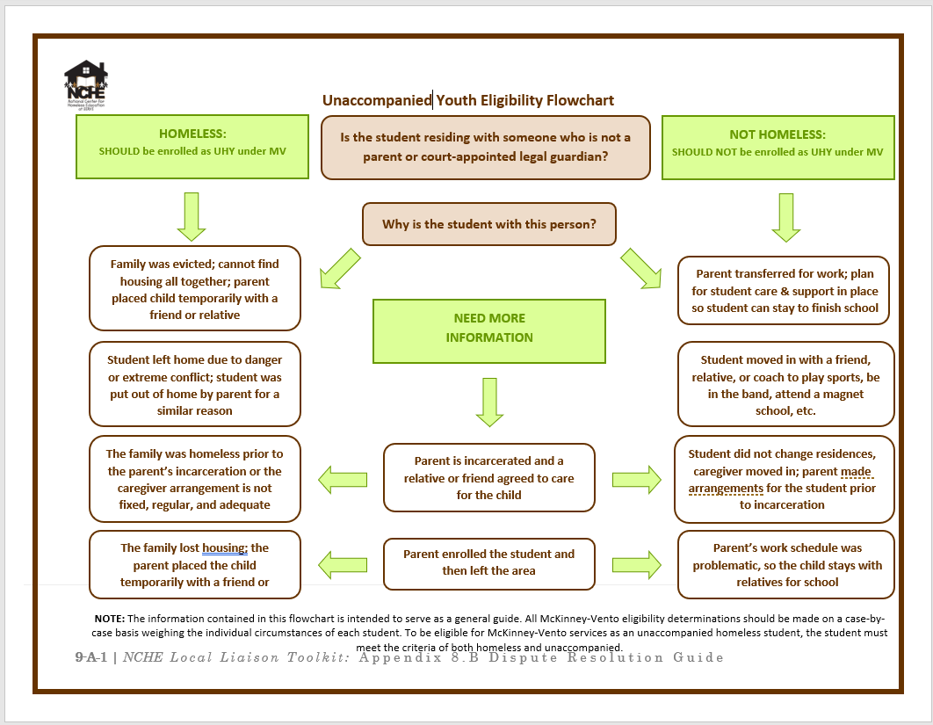

Slide 13
Definition of “School of Origin” 42 U.S.C. § 11432 (g)(3)(I)
The term “school of origin” refers to the school that a child or youth attended when permanently housed or the school in which the child or youth was last enrolled, including a preschool.

Slide 14
Definition of “Enrollment” 42 U.S.C. § 11434a (1)
(1) The terms “enroll” and “enrollment” include attending classes and participating fully in school activities.

Slide 15
LEA Requirements 42 U.S.C. § 11432 (g)(3)
Best Interest
School Stability
Immediate Enrollment
Records Maintenance
Enrollment Disputes
Placement Choice
Transportation

Slide 16
LEA Requirements 42 U.S.C. § 11432 (g)(3)
Contact Information
School of Origin
Comparable Services
Coordination of Services
Homeless Children and Youths with Disabilities
Homeless Liaison

Slide 17
Duties of Local Liaisons 42 U.S.C. § 11432 (g)(6)
Each local liaison should ensure the following occur regarding homeless children and youths:
Identified by school personnel
Enrolled immediately
Have access to/participate in all eligible educational services
Receive referrals to health care and other appropriate services
Informed of educational opportunities available
Public awareness of educational rights

Slide 18
Duties of Local Liaisons 42 U.S.C. § 11432 (g)(6)
Mediate enrollment disputes
Fully inform parent/child of transportation services
Provide PD for school serving homeless children
Offer same opportunities unaccompanied homeless youth
Inform age-appropriate unaccompanied homeless youth of independent status
Verify independent status of unaccompanied youth for FAFSA

Slide 19
Enrollment 42 U.S.C. § 11432 (g)(3)(C)
LEAs are required to immediately enroll homeless children or youth, even if the child or youth
Is unable to produce records normally required for enrollment (immunization records, proof of residency)
Has missed application or enrollment deadlines during any period of homelessness.

Slide 20
Enrollment 42 U.S.C. § 11432 (g)(3)(C)
A school enrolling a homeless child or youth is to adhere to the following:
Contact last attended school to obtain relevant records.
Refer parent or guardian to homeless liaison who will assist in obtaining necessary immunizations, screenings, or records.
Maintain all pertinent records (academic, birth certificates, guardianship, evaluations, etc.)

Slide 21
Enrollment 42 U.S.C. § 11432 (g)(3)(C)
LEAs are to address other problems interfering with the education of homeless children and youths, including problems resulting from enrollment delays that are caused by--
immunization requirements and other required health records;
residency requirements;
lack of birth certificates, school records, or other documentation;
guardianship issues; or
uniform or dress code requirements.

Slide 22
School Selection/Best Interest 42 U.S.C. § 11432 (g)(3)(A)
The LEA is to serve each child or youth according to the child’s or youth’s best interest--
continue the child’s or youth’s education in the school of origin for the duration of homelessness--
(I) in any case in which a family becomes homeless between academic years or during an academic year; and
(II) for the remainder of the academic year, if the child or youth becomes permanently housed during an academic year; or
enroll the child or youth in any public school that non-homeless students who live in the attendance area attend.

Slide 23
School Selection/Best Interest 42 U.S.C. § 11432 (g)(3)(A)
In determining the best interest of the child or youth, the LEA must--
presume that keeping the child or youth in the school of origin is in the child’s or youth’s best interest, except when doing so is contrary to the request of the child’s or youth’s parent or guardian
consider student-centered factors related to the child’s or youth’s best interest: the impact of mobility on achievement, education, health, and safety, giving priority to the request of the child’s or youth’s parent or guardian

Slide 24
School Selection/Best Interest 42 U.S.C. § 11432 (g)(3)(A)
If the best interest determination is contrary to the desires of the parent/guardian or unaccompanied youth, the LEA must—
Provide a written explanation of the reasons for LEA’s best interest determination.
Provide information regarding the right to appeal the LEA’s decision.

Slide 25
Dispute Resolution 42 U.S.C. § 11432 (g)(3)(E)
If a dispute arises over eligibility, school selection, or enrollment--
the child or youth shall be immediately enrolled in the school in which enrollment is sought, pending final resolution of the dispute, including all available appeals;
the parent or guardian of the child or youth must be provided a written explanation of any decisions related to school selection or enrollment made by the school, the LEA, or the MDE, including the rights to appeal.
the Homeless Liaison is to carry out the dispute resolution process as quickly as possible after receiving notice.

Slide 26
Transportation 42 U.S.C. § 11432 (g)(1)(J)(iii)
The LEA is to ensure that transportation is provided, at the request of the parent or guardian to and from the school of origin, as applicable:
If the child or youth continues to live in the area served by the LEA in which the school of origin is located, that LEA is to provide transportation.

Slide 27
Transportation 42 U.S.C. § 11432 (g)(1)(J)(iii)
If the child or youth encounters issues with living arrangements and is no longer living in the area of the school of origin but living in another local attendance zone, the child or youth may continue his or her education in the school of origin; the LEA of origin and the LEA in which the child or youth is living must
Agree upon a method to apportion the responsibility and costs for providing the child with transportation to and from the school of origin.
If the LEAs are unable to agree upon such method, the responsibility and costs for transportation shall be shared equally.

Slide 28
Comparable Services 42 U.S.C. § 11432 (g)(4)
Each homeless child or youth shall be provided comparable services
offered to other students in the school, including--
Transportation services
Educational services based on eligibility criteria, such as Title I services, programs for children with disabilities, and programs for English learners.
Career and technical education programs
Gifted and talented programs
School nutrition programs.

Slide 29
McKinney-Vento/Homeless Authorized Activities 42 U.S.C. § 11433 (d)
Tutoring, supplemental instruction, enriched educational services
Expedited evaluations
Professional Development for instructional support
Referral services for medical, dental, mental, and other health services
Defray excess transportation costs
Developmentally appropriate early childhood education programs

Slide 30
McKinney-Vento/Homeless Authorized Activities 42 U.S.C. § 11433 (d)
Services for attracting and retain homeless students
Before-school, after school and/or summer programs
Payment of fees associated with tracking/transferring records
Training for parents/guardians
Purchase of school supplies
Adaptation of space/supplies for non-school facilities
Emergency assistance needs

Slide 31
LaDewayne Harris
State Homeless Ed. Coordinator
laharris@mdek12.org
601-359-3499

