Slide 1
ELs and RTI (MTSS)
Understanding the RTI (MTSS) Process for English Learners
Special Populations Conference 2017
September 21, 2017

Slide 2
ELs and RTI (MTSS)
Lea Ann Dunklee, Ed.S
ELL Coordinator
Tupelo Public School District
ladunklee@tupeloschools.com
(662)690-5023

Slide 3
ELs and RTI (MTSS)
Objectives:
Best Practices for Tier 1
Best Practices for Tier 2 and Tier 3
Special Education Referrals For ELs Who Have Not Responded To RTI (MTSS)

Slide 4
Best Practices for Tier 1

Slide 5
ELs and RTI (MTSS)-Best Practices for Tier 1
Focus of Tier 1 should be preventing and remediating academic problems
Provide quality curriculum and teaching
More easily identify disabilities and disorders

Slide 6
Language Learning vs Language Acquisition
What is the difference between LEARNING a language and ACQUIRING a language?

Slide 7
Second Language Acquisition (SLA)
Teachers need to understand potential misunderstandings of the Second Language Acquisition process to enhance Tier 1 instruction and reduce inappropriate referrals to Special Education.

Slide 8
Misunderstandings about SLA
Wide range of proficiency
ELs may have a wide range of proficiencies in both languages.
Native language may be stronger in some areas and the second language may be stronger in other areas.
2. Low proficiency in both native language and English
Student X is not very proficient in the native language, so he won’t be very proficient in English.
Classifying students like this is not useful because it encourages low expectations.
HOOVER, J. J. (2016). WHY DO ENGLISH LEARNERS STRUGGLE WITH READING?THOUSAND OAKS: CORWIN SAGE.

Slide 9
Misunderstandings about SLA
3. Native Language Assessments
Native language assessments may yield invalid results.
4. Literacy frameworks developed for monolingual students are adequate for developing literacy skills in a second language.
Literacy instruction for a second language differs from native language literacy.
Explicit instruction of how first language is similar to and different from the second language.
HOOVER, J. J. (2016). WHY DO ENGLISH LEARNERS STRUGGLE WITH READING?THOUSAND OAKS: CORWIN SAGE.

Slide 10
Misunderstandings about SLA
5. More time spent receiving instruction, the faster they will learn the second language.
Time-on-task, by itself, is not sufficient to speed up acquisition.
Students acquire English when they receive instruction that is Comprehensible and at the appropriate level.
HOOVER, J. J. (2016). WHY DO ENGLISH LEARNERS STRUGGLE WITH READING?THOUSAND OAKS: CORWIN SAGE.

Slide 11
Misunderstandings about SLA
6. All ELs learn English in the same way and at the same rate.
The SLA process takes several years.
There are no shortcuts!
Students can appear proficient, but have not acquired full proficiency.
The reason ELs struggle when learning to read is more likely to be the SLA process than a disability.
HOOVER, J. J. (2016). WHY DO ENGLISH LEARNERS STRUGGLE WITH READING?THOUSAND OAKS: CORWIN SAGE.

Slide 12
Misunderstandings about SLA
7. ELs acquire English the same way they acquire their first language.
Children have many years to acquire first language before they start school.
No pressure to understand in order to comprehend grade-level curriculum before applying language in complex, abstract ways.
Older ELs who are literate in their first language may become proficient in written language before oral language.
ELs may be limited in their ability to express themselves in the second language, but are not limited in the ability to think!
HOOVER, J. J. (2016). WHY DO ENGLISH LEARNERS STRUGGLE WITH READING?THOUSAND OAKS: CORWIN SAGE.

Slide 13
Misunderstandings about SLA
8. Errors should always be corrected.
Errors are useful clues to understanding where students are in the Second Language Acquisition process.
He drinked a lot of milk.
HOOVER, J. J. (2016). WHY DO ENGLISH LEARNERS STRUGGLE WITH READING?THOUSAND OAKS: CORWIN SAGE.

Slide 14
Misunderstandings about SLA
9. The majority of ELs in the U.S. are simultaneous bilinguals.
Simultaneous bilinguals learn two languages from birth at the same time.
Sequential bilinguals learn a second language AFTER learning their first language.
Each presents a different set of strengths and weaknesses.
Code-switching is common among bilingual individuals and is not a sign of confusion.
HOOVER, J. J. (2016). WHY DO ENGLISH LEARNERS STRUGGLE WITH READING?THOUSAND OAKS: CORWIN SAGE.

Slide 15
Teaching ELs to Read

Slide 16
Teaching EL students to read
Most Special Education referrals are for students with reading problems. (Machk & Nelson, 2007)
Most Special Education students have reading learning disabilities (Snyder & Dillow, 2012)

Slide 17
Teaching EL students to read
Reading Component | Potential Challenges for ELs
Phonological Awareness | When the native language does not include some English phonemes Student is not accustomed to hearing English sounds Can be difficult to distinguish between sounds Pronunciation and phonological tasks are more difficult

Slide 18
Teaching EL students to read
Reading Component | Potential Challenges for ELs
Alphabetic principle | Letters look the same, but represent different sounds Unfamiliar sounds and various spelling make decoding spelling difficult Not knowing meaning of words can limit use of context clues Learning letters and sounds is very abstract Few opportunities to read aloud and receive feedback

Slide 19
Teaching EL students to read
Reading Component | Potential Challenges for ELs
Vocabulary | ELs can be confused by common words: Prepositions Pronouns Cohesion markers Multiple meaning words Figurative language and idioms False cognates

Slide 20
Teaching EL students to read
Reading Component | Potential Challenges for ELs
Fluency | ELs read more slowly with less understanding Can have an accent and still read fluently Can be good word callers, but have little to no comprehension

Slide 21
Teaching EL students to read
Reading Component | Potential Challenges for ELs
Reading comprehension | Many factors affect reading comprehension including: Oral language proficiency Word recognition skills Fluency Vocabulary knowledge Ability to use comprehension strategies Variations in text structures Interest Cultural differences

Slide 22
Teaching ELs to Read
Secondary level reading is more complex.
Students enter with:
varying grade levels
English Proficiency
native language Proficiency varying levels of academic background
interrupted formal education
At the Secondary Level

Slide 23
Teaching Secondary EL students to read
Different Approaches:
L2 teacher who delivers instruction
Team of L2 and Content teacher
Sheltered Instruction by content teacher
Newcomer schools or programs

Slide 24
ELs and RTI (MTSS) - Understanding the RTI (MTSS) process and how it will help your students succeed
RTI | RTI for ELs
High quality and scientifically based core content curriculum and instruction | ...which allows ELL students full access to the general education curriculum, in addition to language instruction.
Albers, C. A., & Martinez, R. S. (2015). Promoting academic success with English language learners: best practices for RTI. New York: The Guilford Press.

Slide 25
Instruction at Tier 1
Use research-based curriculum that has been scientifically validated to be effective with EL students. (SIOP, Reciprocal Teaching, Guided Reading, etc)
Effective Instructional Principles and Sound Pedagogy
Opportunities to Learn
Differentiation
Direct/Explicit Instruction
Practice and Corrective Feedback
Examine the Learning Environment

Slide 26
Dangerous Assumptions for Tier 1
Evidence-based instruction is good for everyone.
An effective first language instructional approach is an effective second language instructional approach.
Students who fail to respond to research-based instruction MUST have a learning problem or disability.
Notes:
Refer to page 40-41 in Hoover, Baca, Klingner for speaking points

Slide 27
Universal Screeners

Slide 28
ELs and RTI- Understanding the RTI and how it will help your students succeed
RTI | RTI for ELs
Data-based procedures for making decisions Universal Screening procedures Progress monitoring procedures | ...that take into consideration specific language proficiency levels
Albers, C. A., & Martinez, R. S. (2015). Promoting academic success with English language learners: best practices for RTI. New York: The Guilford Press.

Slide 29
Universal Screening
According to Albers and Martinez, two key questions associated with data-based decision making and EL students:
What is the academic health of the EL population in your classroom, grade level, school and/or district?
What is the academic health of the EL population when you consider specific level of ELP in your classroom, grade level, school and/or district?
Albers, C. A., & Martinez, R. S. (2015). Promoting academic success with English language learners: best practices for RTI. New York: The Guilford Press.

Slide 30
Universal Screening
Curriculum Based Measurements (CBM)
According to Albers and Misson, 2014, there is increasing evidence that the same measures used with native English speaking students can be used with ELs to conduct Universal Screening and Progress monitoring.

Slide 31
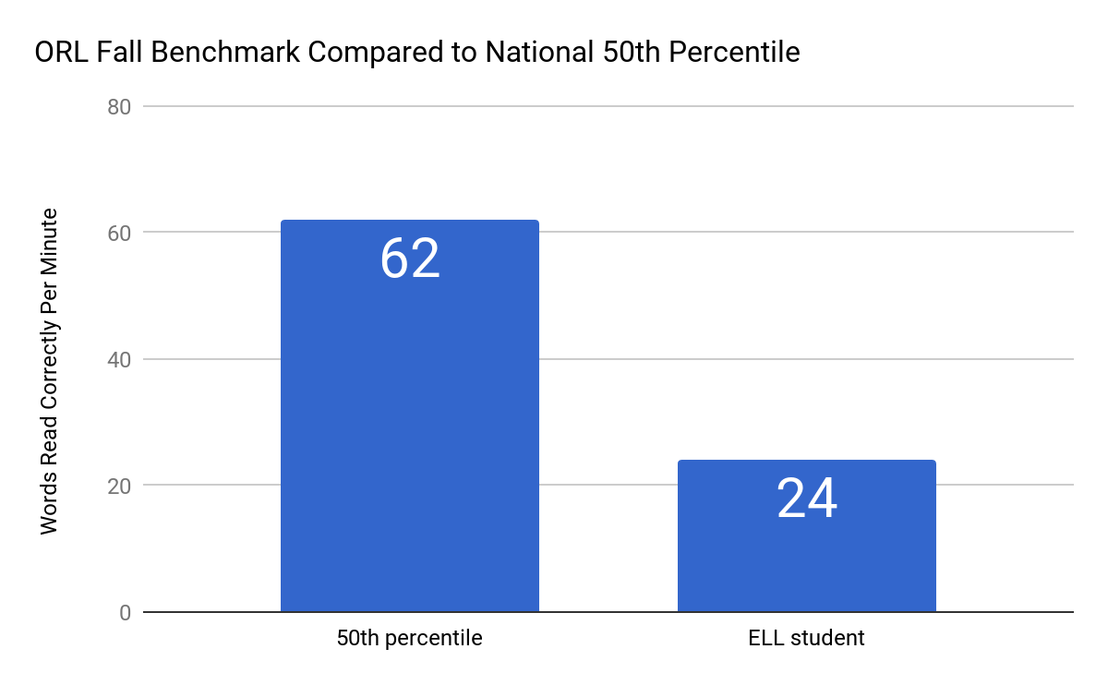
Universal Screening
Albers, C. A., & Martinez, R. S. (2015). Promoting academic success with English language learners: best practices for RTI. New York: The Guilford Press.

Slide 32
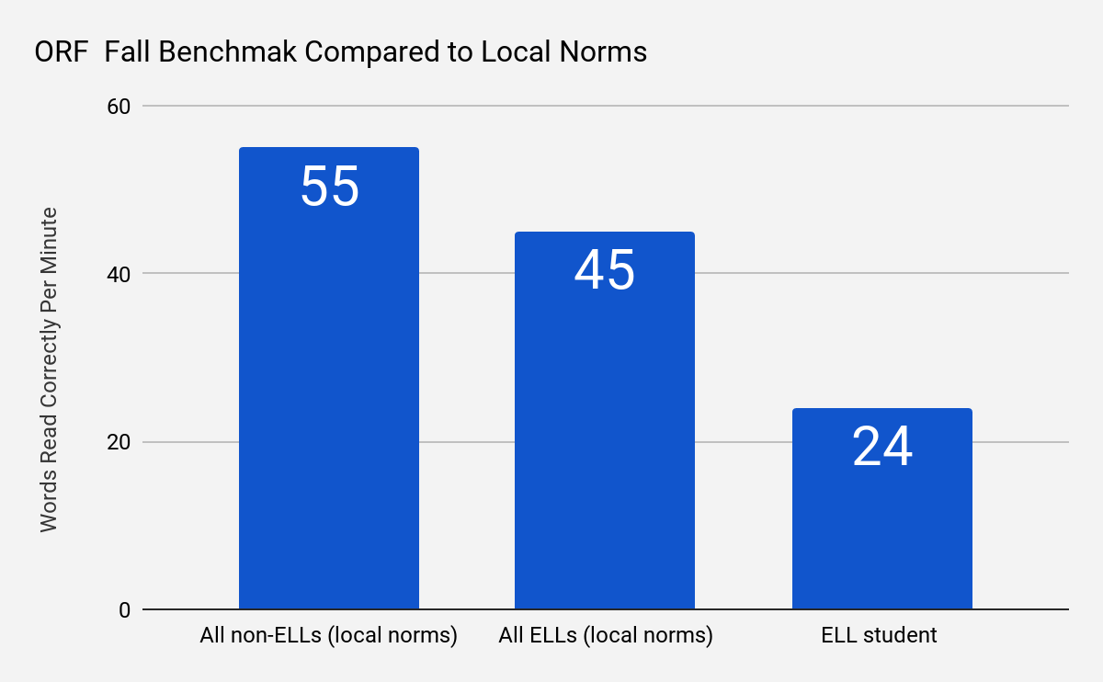
Universal Screening
Albers, C. A., & Martinez, R. S. (2015). Promoting academic success with English language learners: best practices for RTI. New York: The Guilford Press.

Slide 33
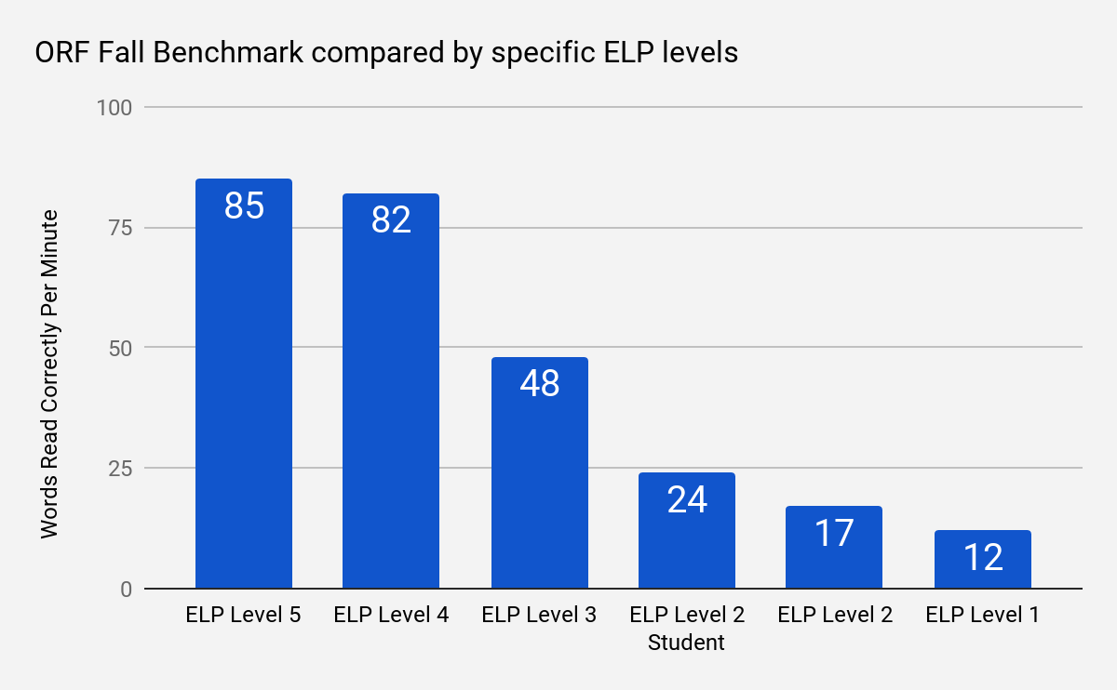
Universal Screening
Albers, C. A., & Martinez, R. S. (2015). Promoting academic success with English language learners: best practices for RTI. New York: The Guilford Press.
Notes:
Student’s specific language proficiency level is necessary but not sufficient to make data-based decisions. Include other data points

Slide 34
Progress Monitoring

Slide 35
Progress Monitoring
Use CBM’s to monitor progress in Tiers 1, 2 and 3.
Compare EL students at same proficiency level.

Slide 36
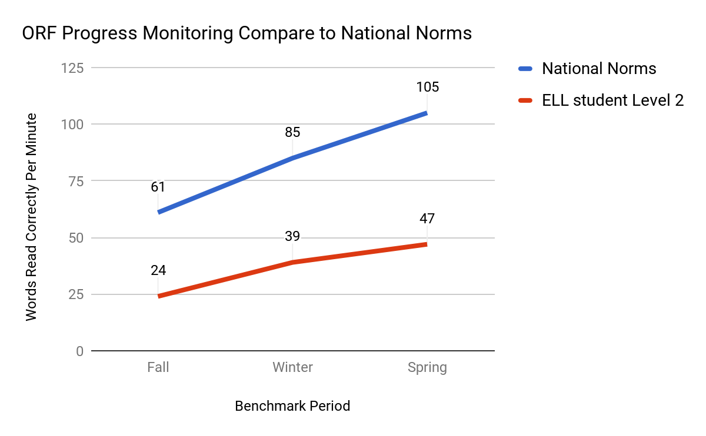
Progress Monitoring

Slide 37
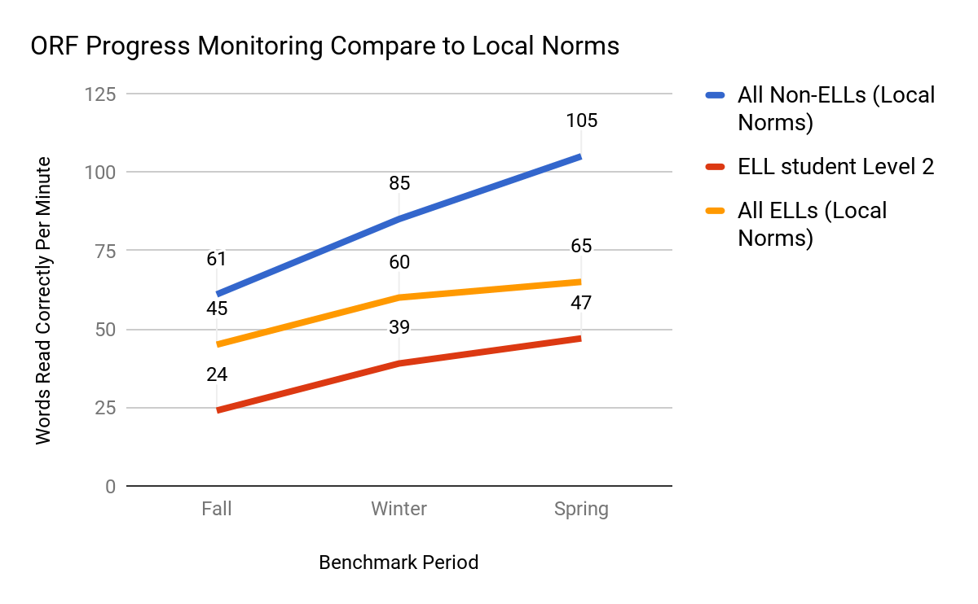
Progress Monitoring

Slide 38
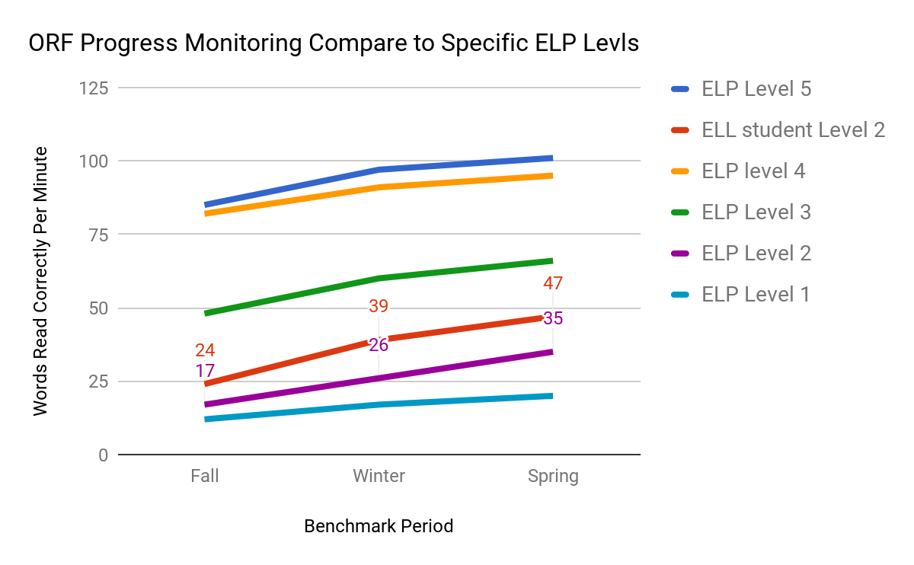
Progress Monitoring

Slide 39
Tier 2 and Tier 3

Slide 40
ELs and RTI- Understanding the RTI and how it will help your students succeed
RTI | RTI for ELs
Well-defined process for determining movement between instructional and intervention tiers | ...that considers language proficiency levels
High-quality and scientifically based interventions | ...that include appropriate interventions for EL students at various proficiency levels
Albers, C. A., & Martinez, R. S. (2015). Promoting academic success with English language learners: best practices for RTI. New York: The Guilford Press.

Slide 41
ELs and RTI- Understanding the RTI and how it will help your students succeed
RTI | RTI for ELs
Procedures for evaluating integrity of implementation of classroom instruction and interventions | ...and language instruction
Procedures for determining special education eligibility | ...that considers ELP level, background information (including exclusionary factors)
Albers, C. A., & Martinez, R. S. (2015). Promoting academic success with English language learners: best practices for RTI. New York: The Guilford Press.

Slide 42
Tiers 2 and 3
Expect to provide many ELs with Tier 2 and Tier 3 supports immediately!!!
There is no need to wait and see if they need extra support.
THEY NEED EXTRA SUPPORT!!

Slide 43
Tier 2 and 3
Learning English and academic content at the same is difficult!!!
They will need scaffolding and interventions.
Tier 2 and Tier 3 mean intensify instruction.
There is no need to purchase more stuff!!

Slide 44
Tier 2 and Tier 3
Increase intensity by manipulating the following:
Group size
Instructional period
Frequency
Duration

Slide 45
Tier 2 and Tier 3
Ideally supplement with evidence-based strategies and interventions that have been vetted to be effective with ELs.
What Works Clearinghouse is an agency that reviews scientific evidence to support educational practices.

Slide 46
Special Education Referral and Evaluation

Slide 47
Special Education Referral and Evaluation
There are two ways to create disproportionality:
Failure to identify and refer
Over referral
It is good practice to adopt the following approach:
Everything that is within our power has been attempted and documented carefully.

Slide 48
Special Education Referral and Evaluation
Making the referral
The million dollar question is:
How do we separate an underlying disability from the second language acquisition process validly and reliably since they both exhibit similar linguistic patterns?

Slide 49
Special Education Referral and Evaluation
Some Similarities Between LD and Language Acquisition
Behaviors Associated with LD | Behaviors when Acquiring an L2
Difficulty with phonological awareness | Difficulty auditorily distinguishing between sounds not in one’s first language, or sounds that are presented in a different order
Difficulty remembering sight words | Difficulty remembering sight words when word meanings are not understood
May have poor auditory memory | Show to process challenging language because it is not well understood.
http://schools.nyc.gov/NR/rdonlyres/DABEF55A-D155-43E1-B6CB-B689FBC9803A/0/LanguageAcquisitionJanetteKlingnerBrief_73015.pdf%20Resources

Slide 50
Special Education Referral and Evaluation
EL Special Education evaluations are only as strong as the pre-referral interventions and documentation.
Documentation should include:
Observations
Assessments
Instructional adaptations
Accommodations
Interventions implemented in the general education classroom.

Slide 51
Special Education Referral and Evaluation
Consideration of exclusionary factors:
Learner Domain
Lack of Appropriate Instruction
Core Curriculum
Classroom/School Disadvantage
Cultural Factors
Economic Factors
Environmental Factors
Address the impact of the exclusionary factors and rule them out.

Slide 52
Special Education Referral and Evaluation
Exclusionary criteria worksheets in this book

Slide 53
Special Education Referral and Evaluation
Exclusionary criteria exist to prevent
a child from being labeled SLD when
no learning disability exists.

Slide 54
ELs and RTI (MTSS)
If
Thank you for participating today!

