Slide 1
Parent and Family Engagement
Public Law 114-95
ESSA Section 1116
June 27, 2018
Barbara Greene Brendsha A. Roby
Parent and Family Engagement Coordinator Director of Schoolwide Development
bgreene@mdek12.org brroby@mdek12.org

Slide 3
State Board of Education Goals FIVE-YEAR STRATEGIC PLAN FOR 2016-2020
All Students Proficient and Showing Growth in All Assessed Areas
Every Student Graduates from High School and is Ready for College and Career
Every Child Has Access to a High-Quality Early Childhood Program
Every School Has Effective Teachers and Leaders
Every Community Effectively Uses a World-Class Data System to Improve Student Outcomes
Every School and District is Rated “C” or Higher

Slide 4
Agenda

Slide 5
Today’s Training Will Cover:
Overview of Parent and Family Engagement
Timelines for Development
ESSA Parent and Family Engagement Changes
District Level Policy
School Level Policy
Building Capacity
School-Parent Compact
Annual Title I Meeting
Resources Available

Slide 6
Overview

Slide 7
Overview
When families, communities and schools work together, students are more successful and the entire community benefits. The family engagement program works when it is inclusive of all families. Districts and schools need to connect to all families, reaching beyond barriers of culture, language, disability, and poverty.
Notes:
Overall, ESSA changes to parent and family engagement Public Law 114-95 Section 1116 are minimal.

Slide 8
Definition

Slide 9
What is Parent and Family Engagement (PFE)?
Notes:
Family engagement is a shared responsibility of families, schools, and communities for all student learning and achievement that continues from birth to young adulthood and occurs across multiple settings where children learn.
Family Engagement is the participation of parents and family members in regular, two-way, and meaningful communication involving student academic learning and other school activities, that only happens when….

Slide 10
What is Parent and Family Engagement (PFE)?
When parents play an integral role in assisting in their children’s learning.
When parents are encouraged to be actively involved in their children’s education.
When parents are full partners in their children’s education and are included, as appropriate, in decision-making and on advisory committees to assist in the education of their children.

Slide 11
Timelines

Slide 12
Timelines and Due Dates
Each Title I served district should develop a timeline to ensure that the district policy has been evaluated and revised (if necessary). Section 1116(a)(2)(D)
Checkpoints throughout the year will ensure that:
parent and family needs are being met, and
schools are provided adequate support and technical assistance in implementing their PFE plans
Notes:
Within ESSA there are changes and updates, Including moving from parental involvement to Parent and Family Engagement. Most of the changes are with the LEA parental involvement policy.

Slide 13
ESSA PFE Updates

Slide 14
Changes and Updates
Conducting outreach
Meaningful involvement of parents and families
Consultation with parent and family engagement stakeholders
Coordinating and integrating services
Addressing the removal of barriers
Implementing evidence-based strategies
Develop a Parent Advisory Board
Notes:
Within ESSA there are changes and updates, Including moving from parental involvement to Parent and Family Engagement. Most of the changes are with the LEA parental involvement policy.

Slide 15
District Level Policy

Slide 16
District Level Policy
The district policy, which is incorporated into the school’s plan, will explain how the district will support schools and families. It will outline, through consultation and input from families, the expectations, goals and objectives the district will undertake to achieve meaningful involvement and engagement. Section 1116 (a)(2)
Notes:
This policy which is folded into the district plan, will explain how the district will support schools and families. Through consultation and input from families, the expectations, goals and objectives the district will undertake to ensure meaningful involvement and engagement will be identified. As we move through this presentation, we will explore all of the components of the district policy. Section 1116(a)(2)(A-F) lists all

Slide 17
Components of the District Level PFE Policy
Each Title I served district must:
Reach out to ALL parents and family members and implement programs, activities, and procedures to involve all parents and family members of participating children. Section 1116(a)(1)
Establish the district expectation for parent and family engagement. Section 1116(a)(2)
Notes:
LEAs (and schools) must actively provide OUTREACH to ALL parents and families. The overall family engagement program needs to be inclusive of all families. LEAS (and schools) need to connect to all families, reaching beyond barriers of culture, language, disabilities, and poverty.

Slide 18
Components of the District Level PFE Policy
Each Title I served district must:
Involve parents and families in:
The joint development of the district’s Title I, Part A plan and
The development of supports and improvement plans.
Section 1116(a)(2)(A)
Notes:
When we think about joint development we want to ensure families are involved throughout the process. We want to make sure we get input, from families for the district plans school plans and the school improvement plans.

Slide 19
Components of the District Level PFE Policy
Each Title I served district must:
Provide the coordination, technical assistance, and other support necessary to assist participating schools in the planning and implementation of effective family engagement activities to improve student academic achievement and school performance.
Section 1116(a)(2)(B)
Notes:
LEAs must first build the capacity of the school personnel. Then they are better equipped to build the capacity of families. LEAs (and schools) must be proactive to elevate the social capital of families. LEAs may choose to partner with community groups as a means to engage families more creatively and successfully.

Slide 20
Components of the District Level PFE Policy
Each Title I served district must:
Coordinate and integrate parent and family engagement strategies, to the extent feasible, across other relevant Federal, State, and local laws and programs.
Section 1116(a)(2)(C)
Notes:
to the “extent feasible” coordinate and integrate strategies. Get out of the “silo” and find ways to work cooperatively with other programs. Title I part A needs to find ways to work with Title I part C and Title III Part A and IDEA and Head Start and other preschool programs.

Slide 21
Components of the District Level PFE Policy
Each Title I served district must:
Conduct, with the involvement of families, an annual evaluation of the content and effectiveness of the parent and family engagement policy in improving the academic quality of the school served, including:
Identifying barriers to greater participation of families in Title I related activities, with particular attention to families who are economically disadvantaged or disabled, and families who have limited English proficiency, limited literacy, or any racial or ethnic minority background;
Section 1116(a)(2)(D)(i)
Notes:
updated: the evaluation is an annual requirement, but include parents in a “meaningful” manner. In addition to surveys consider using focus group and open group discussion for evaluations. Parents and families have a voice, LISTEN.
The annual evaluation of the policy is not new-what is new is addressing the barriers, speaking to those things that deter participation, involvement, and engagement of all parents and families, including English Learner parents, parents with limited literacy, and parents with disabilities.

Slide 22
Components of the District Level PFE Policy
Each Title I served district must:
Identifying needs of parents and families to assist their children ability to learn, including engaging with school personnel and teachers; and
Section 1116(a)(2)(D)(ii)
Identifying strategies to support successful school and family interaction.
Section 1116(a)(2)(D)(iii)
Notes:
The evaluations need to target at least three key areas: barriers, ability to assist learning, and successful interactions.
How will the district help parents and families engage with the schools to better help their children?
What tools will you use to evaluate, or does your evaluation tool identify the type and frequency of school-home interactions and the needs parents and families have to better support and assist their children in learning?
Does your evaluation tool offer strategies that parents and families can use?
Identifying the needs of parents is not just by surveys of parents. It may consist of parents or families requests, noticeable need, teacher’s request, district level request.
Also, some strategies that can support successful school and family interactions are Improved communications, opportunities where teachers and parents learn together, and personalize the training or meeting.

Slide 23
Components of the District Level PFE Policy
Each Title I served district must:
- Use the findings of the evaluation to design evidence based strategies for more effective family engagement; and
Revise the policy, where necessary, to address ways to overcome identified barriers.
Section 1116(a)(2)(E)
Notes:
Use the findings from the evaluation to implement “evidence-based” strategies. Uncover best practices that are working and adapt those ideas to your LEA (and schools) needs.
For example, is transportation an issue. How can the district overcome this barrier? What about language? Time of day? Format of meeting or training?

Slide 24
Components of the District Level PFE Policy
Each Title I served district must:
Involve families in the activities of the schools, which may include establishing Parent Advisory Boards representative of the parents in the district.
Section 1116(a)(2)(F)
Notes:
Although it is a “may” clause, LEAs are encouraged to develop a parent advisory board (PAB). This PAB needs to be of adequate size and appropriate diversity to represent the demographic of the LEA. The primary task of the PAB relates to the LEA.
Historically, we have considered Muffins for Mom, doughnuts for dads, granolas for granny's.. parent engagement activities. ESSA has shifted our focus to those activities that are academically focused, that are goal oriented, that are measurable, and evidence-based.

Slide 25
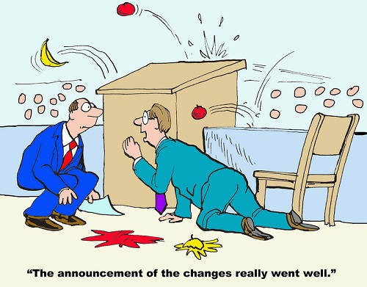
Progress Check

Slide 26
Notes:
Poll Title: Using one emoji, how are you REALLY feeling at this point? https://www.polleverywhere.com/free_text_polls/VCAcPPLJSP30FA3

Slide 27
School Level Policy/Plan

Slide 28
School Level Policy/Plan
Each school shall develop jointly with, agree on with, and distribute to parents and families a written parent and family engagement policy. This policy will describe how the school will carry out the requirements of sub-sections (c) through (f).
Section 1116 (b)(1)
Notes:
The school policy, just as the district policy must be developed jointly with, agreed upon…, must describe the annual meeting-flexible meeting schedules, dissemination of information, development of school compacts…
Also, the Parents and families need to be informed about achievement levels of the state academic standards.

Slide 29
Components of the School Level PFE Plan
Each Title I served school must:
Develop jointly, agree on with, and distribute to families of Title I served students a written parent and family engagement plan that describes the activities that will be carried out.
The plan will be written in an understandable and uniform format and, to the extent feasible, in a language the parents can understand. Section 1116(b)(1)
Notes:
It is important to remember that the School level PFE Plan/Policy must be inclusive. A great way to ensure that that happens is by having a Common Agenda where everyone have a shared vision for change, including a common understanding of the problem and a joint approach to solving it through agreed-upon actions
Collecting data and measuring results consistently across all participants ensure efforts remain aligned and participants hold each other accountable
Activities must be differentiated while still being coordinated through fulfill the goals of the plan
Continuous Communication: Consistent and open communication is needed across the many players to build trust, ensure mutual objectives, and appreciate common motivation

Slide 30
Components of the School Level PFE Plan
Each Title I served school must:
Update the plan periodically to meet the changing needs of the parents and school.
Section 1116(b)(1)

Slide 31
Components of the School Level PFE Plan
Each Title I served school will:
Convene an annual meeting at a convenient time to inform families of their school’s participation in Title I, the requirements of the program, and their rights to be involved.
Section 1116(c)(1)
Offer flexible number of meeting times.
Section 1116(c)(2)

Slide 32
Components of the School Level PFE Plan
Each Title I served school will:
Involve families in the planning, review, and improvement of the Title I programs including:
Parent and Family Engagement Plan and School Plan through:
Planning
Reviewing
Evaluating
Revising Section 1116(c)(3)
Notes:
The school may use a team that is already in place to accomplish this goal, for example, they may include this as part of their school planning team activities.

Slide 33
Components of the School Level PFE Plan
Each Title I served school will:
Provide families of participating children:
Timely information about Title I programs
Description and explanation of the curriculum used
What academic assessments are used to determine student progress?
The proficiency levels students are expected to meet
Section 1116(c)(4)

Slide 34
Components of the School Level PFE Plan
IF requested by families, opportunities for regular meetings to provide suggestions and to participate (if appropriate) in decisions relating to the education of their children and respond to any suggestions.
Section 1116(c)(3)
Provide families the opportunity to submit comments if the school plan is unsatisfactory, and must include all parent comments in the plan when it is submitted to the district for approval. Section 1116(b)(5)
Notes:
???How many of your policies provide opportunities for parents to offer suggestions of any kind?
How do you address comments of parents regarding your school plans?

Slide 35
Components of the School Level PFE Plan
Each Title I served school will:
Jointly develop with families of served children a school-parent compact that outlines how:
Families, the entire staff, and students will share responsibility for improved student academic achievement and how the school and families will build and develop a partnership to assist children in meeting the State’s challenging standards.
Section 1116(d)(1)
Notes:
We will go into further details on the specific components of the school-parent compacts

Slide 36
Components of the School Level PFE Plan
The school will provide high-quality curriculum and instruction in a supportive and effective learning environment that enables the children served to meet the State’s academic standards; and
Section 1116(d)(1)
Each family will be responsible for supporting their children’s learning and participating, as appropriate, in decisions relating to the education of their children and positive extracurricular time.
Section 1116(d)(1)

Slide 37
Components of the School Level PFE Plan
Each Title I served school will:
Create a school-parent compact that addresses the importance of communication between teachers and families on an ongoing basis through, at a minimum:
Parent-teacher conferences in the elementary school at least annually, during which the compact must be discussed;
Section 1116(d)(2)(A)
Notes:
School compacts are required for elementary schools but strongly suggested for all schools

Slide 38
Components of the School Level PFE Plan
Frequent reports to families concerning their children’s academic progress;
Section 1116(d)(2)(B)
Opportunities to volunteer and participate in their children’s class and observe classroom activities;
Section 1116(d)(2)(C)
Regular, meaningful two-way communication between families and the school (and, to the extent practicable, in a language families can understand).
Section 1116(d)(2)(D)

Slide 39
Components of the School Level PFE Plan
Opportunities for parents to be involved in the activities of the school (such as, parent advisory councils).
Section 1116(a)(2)(F)

Slide 40
Progress Check
Join with the
Kahoot! app
or at
kahoot.it

Slide 41
Progress Check

Slide 42
District Policy and School Policy/Plan

Slide 43
Components of Both District and School Level
Each Title I served district and school will build capacity for involvement by:
Providing assistance to parents of Title I students in understanding the State’s challenging academic standards, State and local assessment requirements, and how to monitor their children’s progress while working with school staff to improve academic success.
Section 1116(e)(1)
Notes:
There are components of the district level policy and the school level policy/plan-

Slide 44
Components of Both District and School Level
Providing materials and training to help parents with their children to improve student achievement in areas such as literacy training or the use of technology.
Section 1116(e)(2)
Notes:
Included in this section-which is new-is the education about the harms of copyright piracy

Slide 45
Components of Both District and School Level
Educating teachers, instructional support personnel, principals, and other staff about:
Valuing and utilizing contributions of parents
Reaching out to, communicating with, and working with parents as equal partners
Implementing and coordinating parent programs
Building ties between parents and the school
Section 1116(e)(3)

Slide 46
Components of Both District and School Level
To the extent feasible and appropriate:
Coordinating and integrate parent involvement programs and activities with other Federal, State, and local programs (including public preschools)
Conducting other activities, such as parent resource centers, that encourage and support parents in fully participating in their children’s education
Section 1116(e)(4)

Slide 47
Components of Both District and School Level
Ensuring that information related to school and parent programs, meetings, and other activities is sent to the parents of participating children in a format and, to the extent practicable, in a language the parents can understand, and providing opportunities for the informed participation of parents and family members.
Section 1116(e)(5) and Section 1116(f)

Slide 48
Components of Both District and School Level
Each Title I served district and school may build capacity for involvement by:
Involving parents in the development of training for teachers, principals, and other educators to improve the effectiveness of such trainings. Section 1116(e)(6)
Providing necessary literacy training from funds received from Title I, Part A if the district has exhausted all other reasonably available sources of funding for training for parents. Section 1116(e)(7)
Notes:
These activities are not required, however, they may be implement to demonstrate that the district and school level policies/plan meet ESSA requirements. You could provide parents opportunities to sit in on professional development plans for teachers and other school staff.
Focus on literacy trainings for parents to help their children at home. This applies to all grade levels, in turn providing parents the abilities to understand the complexities of what their children must accomplish.

Slide 49
Components of Both District and School Level
Paying reasonable and necessary expenses associated with parental engagement activities, including transportation and child care costs that will enable parents to participate in school-related meetings and training sessions.
Section 1116(e)(8)
Training parents to enhance the involvement of other parents. Section 1116(e)(9)
Notes:
The policy/plan may address providing REASONABLE and NECESSARY expenses so that parents and families can attend parent and family engagement activities. You may pay to run a bus route to pick up parents and return them home in areas that are further away from the meeting site. You may pay a school employee to provide child care while parents attend school-related meetings and training sessions.
You may offer training to train other parents in being the engager for the school or district. To actually take information out to the community and get other parents engagement in the improvement of their child’s or the school as a whole.

Slide 50
Components of Both District and School Level
Arranging school meetings at a variety of times, or conducting in-home conferences between teachers or other educators who work directly with the participating children, with parents who are unable to attend such conferences at school, in order to maximize parental involvement and participation. Section 1116(e)(10)
Adopting and implementing model approaches to improve parental involvement. Section 1116(e)(11)

Slide 51
Components of Both District and School Level
Establishing a district wide parent advisory council to provide advice on all matters related to parental involvement in programs supported by Title I, Part A.
Section 1116(e)(12)
Developing appropriate roles for community-based organizations and businesses in parent involvement activities. Section 1116(e)(13)
Providing other reasonable supports for parental involvement requested by parents. Section 1116(e)(14)

Slide 52
Components of Both District and School Level
Each Title I served district and school will have their district policy and school policy/plan monitored to determine if the policies and practices meet the requirements of Title I, Part A.
Section 1116(h)

Slide 53
Progress Check

Slide 54
School-Parent Compact

Slide 55
School Compacts
Each school shall jointly develop with parents of participating children, a school-parent compact that outlines how parents, the entire school staff, and students will share responsibility for improved student academic achievement and the means by which the school and parents will build and develop a partnership to help children achieve the State’s high standards.
Section 1116 (d)
Notes:
The school compacts are required for elementary schools but strongly recommended high schools.
It serves as a clear reminder o fall stakeholders' responsibility to take action at school and at home so that children can attain the state’s academic achievement standards.
The compact can serve as a valuable tool to effectively and meaningfully engage the school ad the home in supporting the academic developments and needs of the students,
Its like a compass pointing to the destination of student success.

Slide 56
School Compacts
The compact shall:
Describe the school’s responsibility to provide high quality curriculum and instruction.
Address the importance of communication between teachers and parents on an ongoing basis through:
Parent-teacher conferences in elementary schools
Frequent reports to parents on their children’s progress Section 1116 (d)(1)(2)(A-D)

Slide 57
School Compacts
The compact shall:
Reasonable access to staff, opportunities to volunteer and participate in their children’s class, and observation of classroom activities
Regular two-way, meaningful communication between family members and school staff, and, to the extent practicable, in a language that family members can understand
Section 1116 (d)(1)(2)(A-D)

Slide 58
School Compacts-Steps to Success
Motivate and Designate
Explain at a staff meeting what compacts are and how they contribute to student success
Pick a team leader and build a team
Develop a timeline and use it to assign tasks
Access your families interests and strengths
Don’t forget the students
How will they take responsibility for their learning?
What do they want teachers and parents to do to support them?

Slide 59
School Compacts-Steps to Success
Gather and Align
Step-by-step process for translating your goals, linking them to priorities in the schoolwide plan, and then identifying specific home learning strategies to carry out the priorities
Align compact with schoolwide plan
Use Data teams to identify three goals per grade level and home learning ideas to discuss with parents

Slide 60
School Compacts-Steps to Success
Design and Develop
Five tools to help the committee translate the data, goals, and priorities into a meaningful school-parent compact.
Sample School-Parent Compact templates
Guide to Quality rubric
School-Parent Compact template (blank)
School-Parent Compact checklist
Questions to review the design and develop process

Slide 61
School Compacts-Steps to Success
Celebrate, review, and revise
View the compact as a cycle of continuous improvement.
Celebrate success
Continuous improvement means reviewing what worked, what needs to improve, and then revising or developing a new plan
Build momentum for next year

Slide 62
School Compacts-Steps to Success
It’s All About The Conversation!
One outcome of developing the school-parent compact should be making connections and establishing collaborative partnerships-teachers talking to families, schools talking to community organizations-people working together to support student learning.

Slide 63
Progress Check

Slide 64
Notes:
Poll Title: What questions do you have concerning the requirements of the School-Parent Compact? https://www.polleverywhere.com/free_text_polls/dghKYdiRZejvlNw

Slide 65
Annual Title I Meeting

Slide 66
Annual Title I Meeting Requirements
All schools receiving Title I, Part A funds are required to convene an annual Title I, Part A parent meeting to:
Inform parents and families of their school’s participation
Explain the requirements of Title I, Part A program
Inform parents of their rights to be involved.
Section 1116(c)(1)
Notes:
During this meeting, schools should emphasize the rights of parents to be involved and share ways they can be involve-volunteering, observing classroom activities, assisting and reviewing policies, compacts, and school plans. Also serve on advisory boards.

Slide 67
Topics for Discussion
The LEA Title I Plan addresses how Title I, Part A funds will be used within the district. Elements of the Plan may include:
High-quality student academic assessments
Supplemental services to assist struggling students
Coordination and integration of federal funds and programs
Section 1116 (a)(3)(D)
Notes:
These topics may be presented in various ways to ensure parents and families are equal partners in their child’s education

Slide 68
Topics for Discussion
The LEA Title I Plan addresses how Title I, Part A funds will be used within the district. Elements of the Plan may include:
Strategies to implement effective parent and family engagement
Emphasis on Title I, Part A parents have the right to be involved in the development of this plan
Section 1116(a)(3)
Notes:
These topics may be presented in various ways to ensure parents and families are equal partners in their child’s education

Slide 69
Templates and Resources

Slide 70
Templates
Parent-Student-Teacher Compact
School-Parent Compact-Traditional Template
Family Engagement Best Practices Rubric

Slide 71
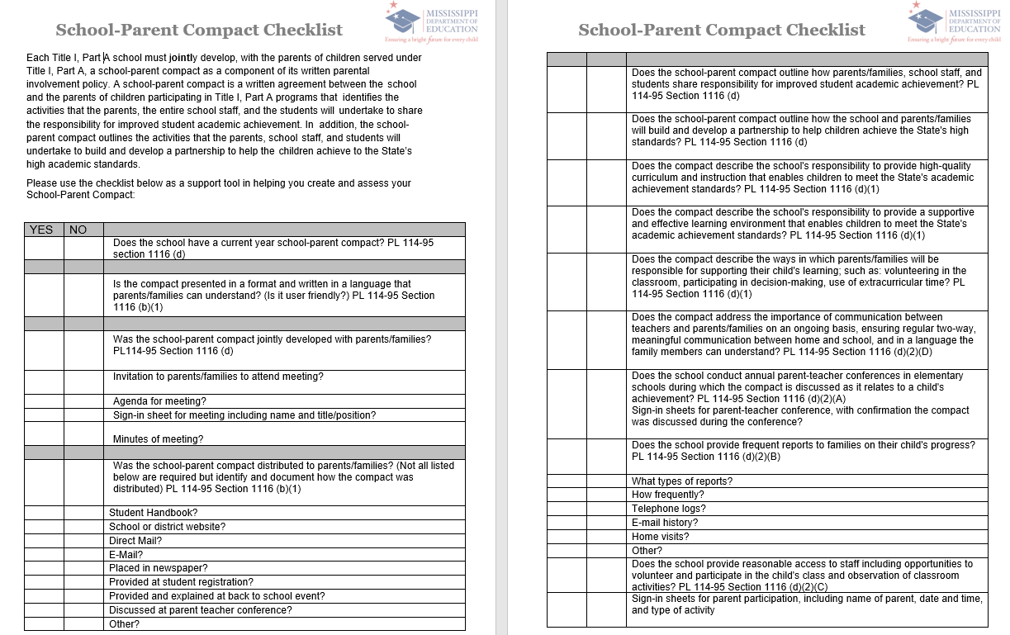
Templates

Slide 72
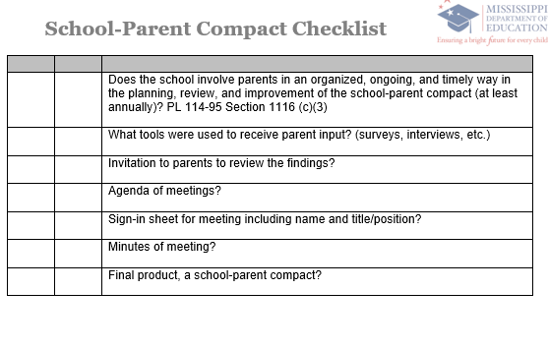
Templates

Slide 73
Resources
Coalition for Community Schools
National Standards for Family School Partnerships
National Dropout Prevention Center/Network
United States Department of Education
ESSA-Parent and Family Engagement Provision
Parental Involvement: Title I, Part A Non-Regulatory Guidance

Slide 74
Resources
ESSA Section 1116 Parent and Family Engagement
ESSA Quick Brief on the Every Student Succeeds Act
Mississippi Department of Education’s Literacy Resources for Parents
Mississippi Department of Education’s Family Guides for Student Success

Slide 75
Resources
Evidence practices at School: A Guide for Parents
Evidence based practices for supporting and enhancing Family Engagement
What’s in it For Parents
Quick Brief on Family Engagement in Every Student Succeeds Act
Title I, Parent and Family Engagement Handbook

Slide 76
Progress Check

Slide 77
Notes:
Poll Title: Using one emoji, NOW how are you REALLY feeling at this point? https://www.polleverywhere.com/free_text_polls/IpDOCM4qkY4a8So

Slide 78
Mr. Quentin Ransburg, Executive Director
Office of Federal Programs
Mrs. Judy Nelson, Bureau Director
District and School Support
Brendsha A. Roby, Director
Division of Schoolwide Development
Barbara Greene, Coordinator
Parent and Family Engagement
601.359.3499
federalprograms2@mdek12.org

