Slide 1
Title I and the Needs of Special Student Populations
Meeting the Needs
September 21, 2017
Brendsha A. Roby
Office of Federal Programs
Director of Schoolwide Development

Slide 3
State Board of Education Goals FIVE-YEAR STRATEGIC PLAN FOR 2016-2020
All Students Proficient and Showing Growth in All Assessed Areas
Every Student Graduates from High School and is Ready for College and Career
Every Child Has Access to a High-Quality Early Childhood Program
Every School Has Effective Teachers and Leaders
Every Community Effectively Uses a World-Class Data System to Improve Student Outcomes
Every School and District is Rated “C” or Higher

Slide 4
Office of Federal Programs Vision, Mission, and Goals
Vision The vision of Mississippi State Board of Education is to create a world-class educational system that gives students the knowledge and skills to be successful in college and the workforce, and to flourish as parents and citizens.
Mission In support of this vision, the mission of the Office of Federal Programs (OFP) is to provide leadership in the effective use of federal funds so that all students are prepared to compete in the global community.
Goal 1 To collaborate across the agency in support of state initiatives | Goal 2 To support district planning and implementation | Goal 3 To evaluate and monitor performance

Slide 5
Dedicated Email
federalprograms2@mdek12.org

Slide 6
Training Overview
Upon completion of this training participants will:
Begin preparing to strengthen family engagement services for these specific populations
Understand the needs of EL, migrant, homeless, and neglected and delinquent students and families
Know how Title I can be used to meet student and family needs

Slide 7
Parent and Family Engagement

Slide 8
Family Engagement Requirements
28 mentions of parent and family engagement in ESSA
Involvement of parents and families of our special populations
Removal of barriers that prevent participation
Building the capacity of parents and families to:
Assist with the learning process of their children
Engage with school personnel and teachers

Slide 9
Why does Family Engagement Matter?
Research has consistently shown that when families are involved in the education of children, academic success is more likely.
With support, families can contribute to the life of the school through volunteering, partnerships and other support.

Slide 10
Migratory Children

Slide 11
Who are migrant students?
A child who is, or whose parent or spouse is, a migratory agricultural worker, including a migratory dairy worker, or a migratory fisher, and who, in the preceding 36 months, in order to obtain temporary or seasonal employment in agricultural or fishing work:
Has moved from one district to another;
In a state comprised of a single school district, has moved from one administrative area to another within such district; or
Resides in a school district of more than 15,000 square miles and migrates a distance of 20 miles or more to a temporary residence to engage in a fishing activity.

Slide 12
What are the needs of migrant students?
Some common needs include:
Academic support, including tutoring, after-school and summer programs
Support in English language acquisition
Opportunities for credit recovery
School supplies, internet access, meeting of some basic physical needs

Slide 13
Understanding the Migrant Lifestyle
Be aware that the migratory lifestyle causes many families to have irregular schedules with strict time constraints and financial limitations.
Extreme flexibility, consideration, and gentle persistence are key elements to begin establishing a solid home-school/community relationship.

Slide 14
Tips for Engaging Migrant Families
Location, day/time for any meetings and events should be constructed around the family’s schedule.
Transportation is an issue for many migrant families, even for families with access to a vehicle.

Slide 15
Potential Barriers to Engagement
Consider Maslow’s Hierarchy of Needs – due to the extreme circumstances faced by many migrant families, parents may be preoccupied in meeting basic needs for the family.
Due to negative experiences, families may feel scared and intimidated, preferring to remain in seclusion rather than take risks to connect with others.

Slide 16
Reaching Migrant Families
Make home visits to begin building relational bonds and acquire a deeper understanding of how best to serve the family and community.
Connect migrant families to other families, organizations, and agencies that can offer assistance. Use networks to establish a support hub for the families.
Example: collect donations of clothing, furniture, and nonperishable food to keep on hand for migrant families in need.

Slide 17
How can Title I support migrant students and families?
Extended day or year programs
Family engagement events that help equip families to support students academically or participate more in school life
Credit recovery
Tutoring
Counseling

Slide 18
How can Title I support? (cont’d)
Programs that support learning of English for students and families
Trauma informed care programs that support students and educate staff
Professional development for staff

Slide 19
Neglected & Delinquent Students

Slide 20
Neglected Facilities
An eligible facility is a public or private residential facility, other than a foster home, that is operated primarily for the care of children and youth who have been committed to the institution or voluntarily placed their under applicable state law due to:
abandonment,
neglect, or
death of their parents or guardians.

Slide 21
Delinquent Facilities
An eligible facility is a public or private residential facility, other than a foster home, that is operated primarily for the care of children and youth who have been adjudicated to be delinquent or those in need of supervision.

Slide 22
What are the needs of neglected students?
Counseling and mental health services
Trauma informed care (services for students)
Trauma informed care (training for educators)
Credit recovery
Academic supports
Clothes, shoes, school supplies
Clean laundry

Slide 23
What are the needs of families of neglected students?
Events that help families learn how to engage in school and home life
Mental health services
Trauma informed care services and information
Non-threatening ways to participate in school life
Connections with caring, emotionally healthy adults

Slide 24
What are the needs of delinquent students?
Behavior interventions (MTSS, PBIS, etc.)
Academic supports
Counseling
Trauma informed care services for students
Trauma informed care training for educators
Motivation for attendance and graduation
Information on and motivation for college/career

Slide 25
Transition Plans
All students who reside in delinquent facilities must have a transition plan, which outlines services to be received when the student returns to school and the community.
Efforts should be made to have families, especially parents, participate in the development of transition plans.

Slide 26
Support for Families with Delinquent Students
Counseling
Trauma informed care
Mental health services
Family engagement events that equip families to support students academically
Non-threatening ways to participate in school life
Events that equip families to support students academically

Slide 27
How can Title I support N and D students?
Professional development for educators
Trauma informed care programs/training
Counseling
Mental health services
Family engagement opportunities/supports
Behavior interventions

Slide 28
Title I Supports (cont’d)
Tutoring
Dropout prevention
Academic supports
Mentoring

Slide 29
Homeless Students

Slide 30
Identifying Homeless Families
Some families prefer not to be labeled as homeless and children often don’t realize they are considered homeless.
Consider using phrases like “between housing” or “now that you live between X and X.”

Slide 31
Engaging Homeless Families
Talk to the family about what specific supports are needed.
Don’t assume that a particular support is either needed or desired.
Consider the least intrusive way to provide supports.

Slide 32
Possible Supports for Homeless Families
Uniforms
School supplies
Assistance with fees
Assistance securing school records from prior schools
Toiletries
Tutoring

Slide 33
Ways to Serve Homeless Families
Help connect homeless families with existing community resources when possible.
Be sure to maintain privacy.
Consider going where the student’s family typically can be found to share school information.

Slide 34
Other Services for Homeless Students
Provide the student a small place to store hygiene items.
Ensure that families understand their rights under the McKinney-Vento Act.

Slide 35
Effective Practices
Collaborate with school supports and with LEA homeless liaison.
Refer the student for academic services (such as tutoring, intervention, etc.).
Suggest participation in extra-curricular activities.
Collaborate and communicate with families.
Work with other departments in your school and district.
Food Services, Transportation, SPED, Family Resource Center, Family Engagement, Coordinated School Health

Slide 36
Effective Practices
Ensure that out-of-class assignments contain realistic expectations (project materials, computer and/or internet access).
Partner with community agencies & businesses.
Food banks, post-secondary institutions, non-profits, public libraries, Boys & Girls Club, HUD, Health Department, etc.
Create support teams for students to include a mentor/advocate who meet regularly to discuss issues, needs, concerns, and reasons to celebrate.

Slide 37
Services
If the student is attending a Title I school, they are Title I students first.
Priority should be given to students who are failing or most at risk of failing to meet the challenging State academic standards.
Remediation
Interventions
Enrichments
Any other services provided to students

Slide 38
English Learners

Slide 39
The Federal Definition of an EL Student
An individual-
Who is age 3-21;
Who is enrolled or preparing to enroll in an elementary or secondary school;
Who was not born in the United States OR whose native language is a language other than English;
Where difficulties in speaking, reading, writing, or understanding the English language may be sufficient to deny the individual
The ability in meeting the State’s proficient level of achievement on State assessments described in section 1111(b)(3)
The ability to successfully achieve in classrooms where the language of instruction is English; or
The opportunity to participate fully in society.

Slide 40
Common Needs of English Learners
Language acquisition
Extended day/year
Credit recovery
Support to families who need help supporting students academically

Slide 41
Relationship Building
Becoming culturally competent and cognizant of the struggles ELs face is a critical first step to establishing a home-school and home-community connection.
Push yourself to make sure they know that you truly care and are here to support them.
Families will not be motivated to engage if they do not feel that they are valued and appreciated.

Slide 42
Cultural Integration and Celebration
Foster an environment where parents are invited to share their language and culture.
Make an effort to incorporate multicultural elements into curriculum, events, and programs to make all cultures feel at home and included.
Avoid stereotypes and language that could pose an offense.

Slide 43
Parental Empowerment
Solicit feedback from parents and continually conduct informal/formal needs assessments as a guide.
Provide support services specifically for EL families, suited to their unique needs.
Example: Practical workshops on skills EL parents can employ to support their children’s education in the home.

Slide 44
Tips for Working With Translators
Plan for meetings to take about twice as long.
Keep language simple.
Remember to make eye contact/focus body language on the family, not the translator.
Be especially mindful of your body language and tone.

Slide 45
Translation Tools
Google Translate
Microsoft Word
Siri might be used for a quick, simple translation.

Slide 46
Tips for Using Translation Tools
Keep sentence structure simple.
Do not add unnecessary adjectives or adverbs for emphasis.
Consider having materials reviewed by a native speaker if possible.
Put translated language back into English and check for accuracy.

Slide 47
How Title I Can Support ELs
Academic supports
Professional development for staff
Family engagement events
Extended day/year programs
English language acquisition supports for both students and families

Slide 48
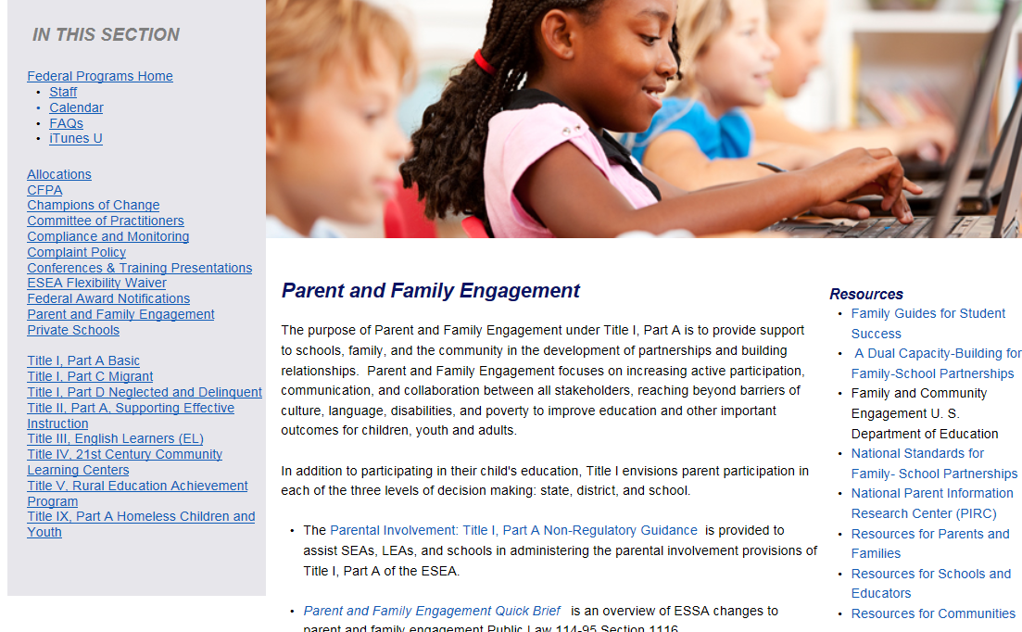
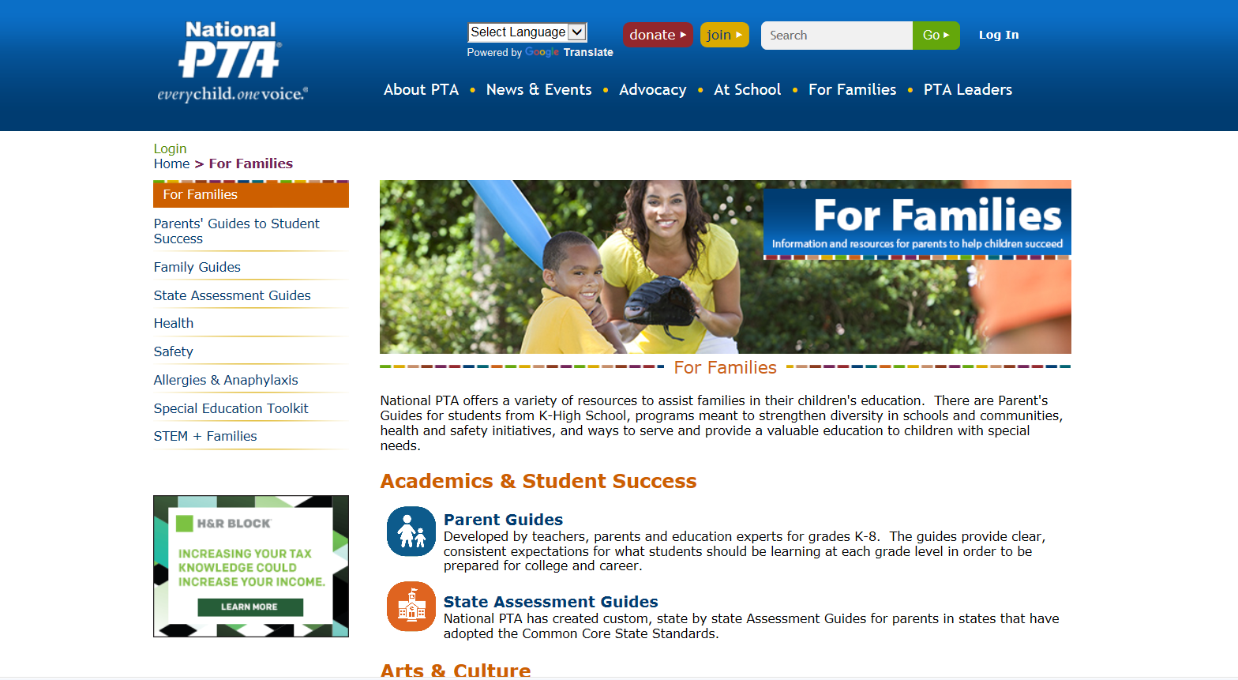
Resources
MDE’s OFP
National Center for Families Learning
National PTA

Slide 49
Questions?

Slide 50
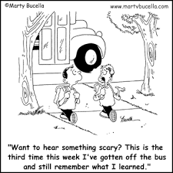

Slide 51
For more information
Call Your District Contact
601.359.3499
Federalprograms2@mdek12.org

